Slide 1

Perform Approval Queue

Slide 2
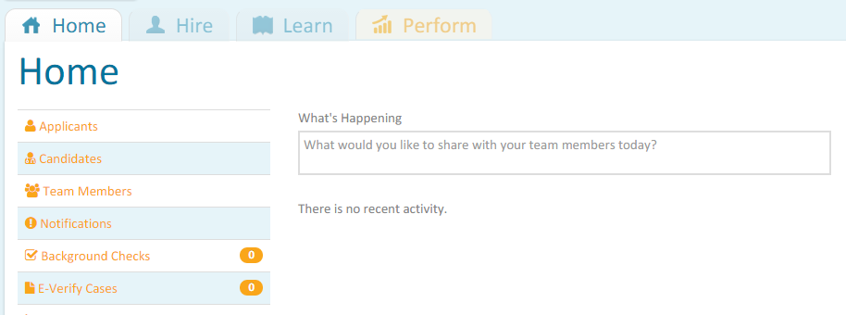
Approval Queue
Forms may be setup to require a Sign off by a person or persons beyond the immediate manager. This is also how the Employee, Manager and others will attach their digital signatures to the form.
This is not actually an Approval, but a way for a person to access the form BEFORE it is considered complete.
The Subject of the email will be Notice of Pending Approval. It will identify you and the person about whom the form has been completed by the Manager.
Once you receive the email you can log into PeopleMatter and go to the Perform Tab.
Notice

Slide 3
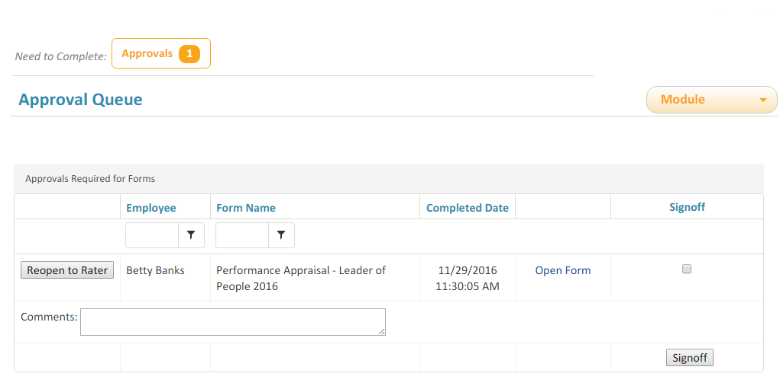
Approval Queue
Viewing the Form
When you log in you will have an Approval Button at the top of the screen. This is not an Approval, but a way for you to review/sign off on the form. The button will not be present if you have no items in your queue.
The Form is available as a PDF by clicking on Open Form. You can go back into your queue as often as you like. The forms will remain available as a PDF from this location until you Sign off or Reopen to Rater.
The Comments field is a place for anyone to enter PUBLIC comments – meaning they will appear by the digital signature of the person who enters them. They are primarily used by Team Members.

Slide 4
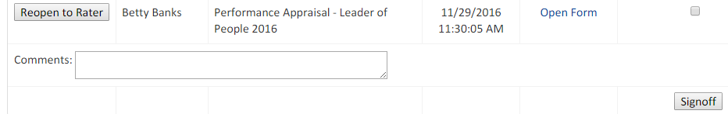
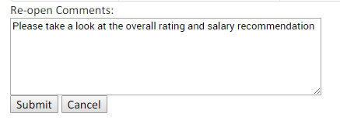
Approval Queue
Sign Off & Reopen to Rater
Once in you have viewed the PDF you have 2 options.
If you want to Sign Off on the form as it is, check the box in the Signoff column and then click the Signoff button. This will make the form complete in the system or move it to the next reviewer.
What if you see issues and what to reopen the form to the rater . . .
REOPENING A FORM SHOULD ONLY BE DONE BY REVIEWERS BEYOND THE RATING MANAGER
If you want to Reopen the form and send it back to the original Rater, click the Reopen to Rater Button. That will open a Comment box in which you can type the comments you want to go back to the Rater. They will be included in the email to the Rater announcing that the form has been reopened. Once the form is saved again, the Sign off process starts over.

Slide 5
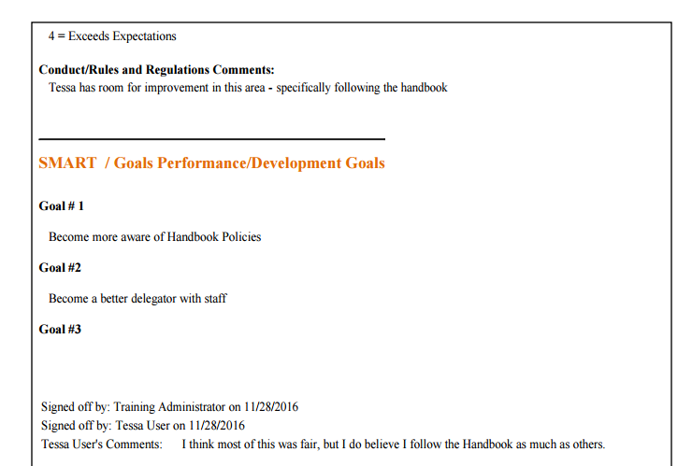
Sample of a Form with Digital Signatures
They appear on the bottom of the last page of the PDF

